Slide 1
CS3003: Lecture 11
What are we doing here, really?

Slide 2
Learning Objectives
By the end of class today, you will be able to
learn attribute grammar
define and build a recursive-descent parser;
understand why direct left-recursive grammar rules are "bad";
eliminate direct left-recursion;

Slide 3
Static Semantics
Additional restrictions on legal programs that can be calculated statically (i.e., by the compiler).

Slide 4
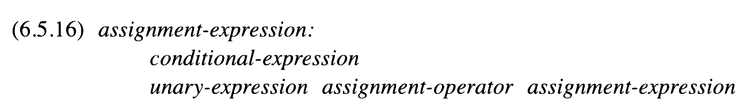
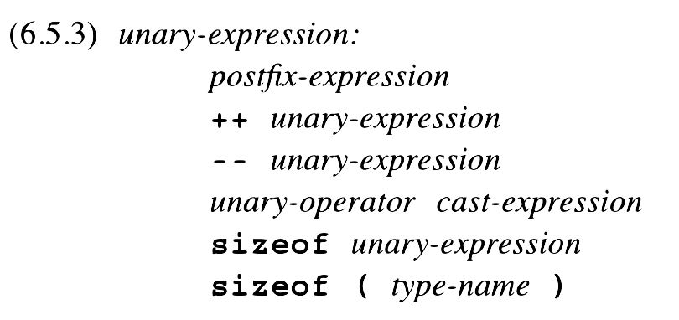
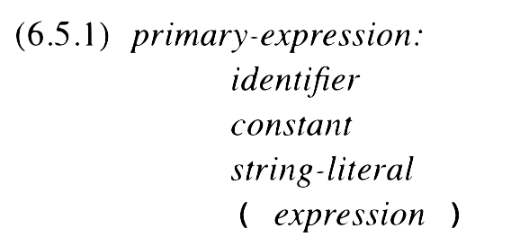
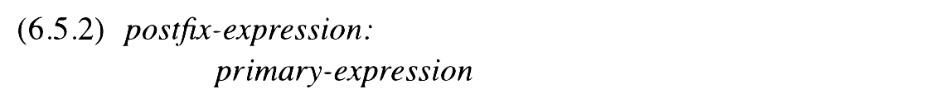
Are You For Real?

Slide 5
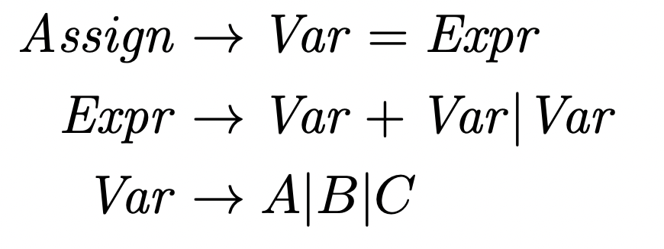
Assignment
What can’t this capture?

Slide 6
Attributes and Predicates
An assignment must be done to a variable with matching type.
A variable has a type declared from earlier code (and it is stored in the symbol table).
Two variables added together have
The variables’ types (when they match)
Real (when they do not)

Slide 7
Derivation

Slide 8
Static Semantics Using Attribute Grammars
Attribute Grammar: An extension of a CFG that adds (semantic) information to its productions.
Attributes:
Inherited: Attribute calculated using peer or parent nodes.
Synthesized: Attribute calculated using only child nodes.
Intrinsic: Attribute calculated from outside the parse tree.
Predicates: Boolean-valued functions that determine whether a derivation can proceed.

Slide 9
Attributes and Predicates
Expected Type: The type that is expected for the expression. Inherited. (Abbreviated x)
Actual Type: The actual type of the expression. Synthesized. (Abbreviated a)
Predicate: In certain cases, these must match!

Slide 10

Attributes and Predicates
V
E
Attributes:
E.x = V.a

Slide 11

Attributes and Predicates
E
V₁
V₂
V₃
Attributes:
if (V₁.a == V₂.a && V₁.a == int)
E.a = int
else
E.a = real
E.a = V₃.a
Predicate:
E.a == E.x

Slide 12

Attributes and Predicates
V
Attributes:
V.a = lookup(A | B | C)

Slide 13
Derivation

Slide 14
Compiler – Generator or Recognizer?

Slide 15
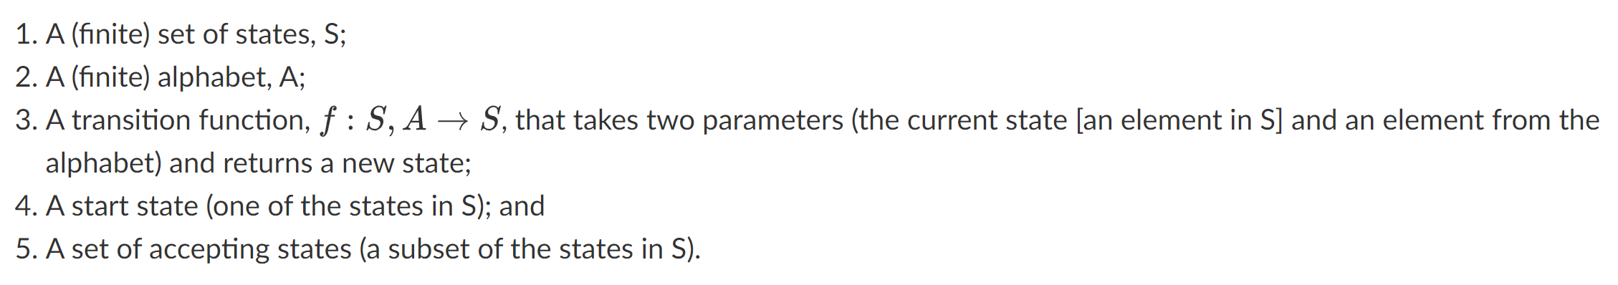
Finite Automata

Slide 16
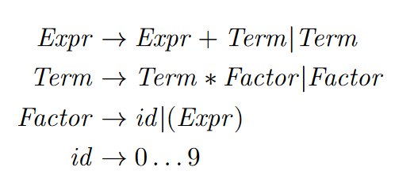
Revisiting

Slide 17
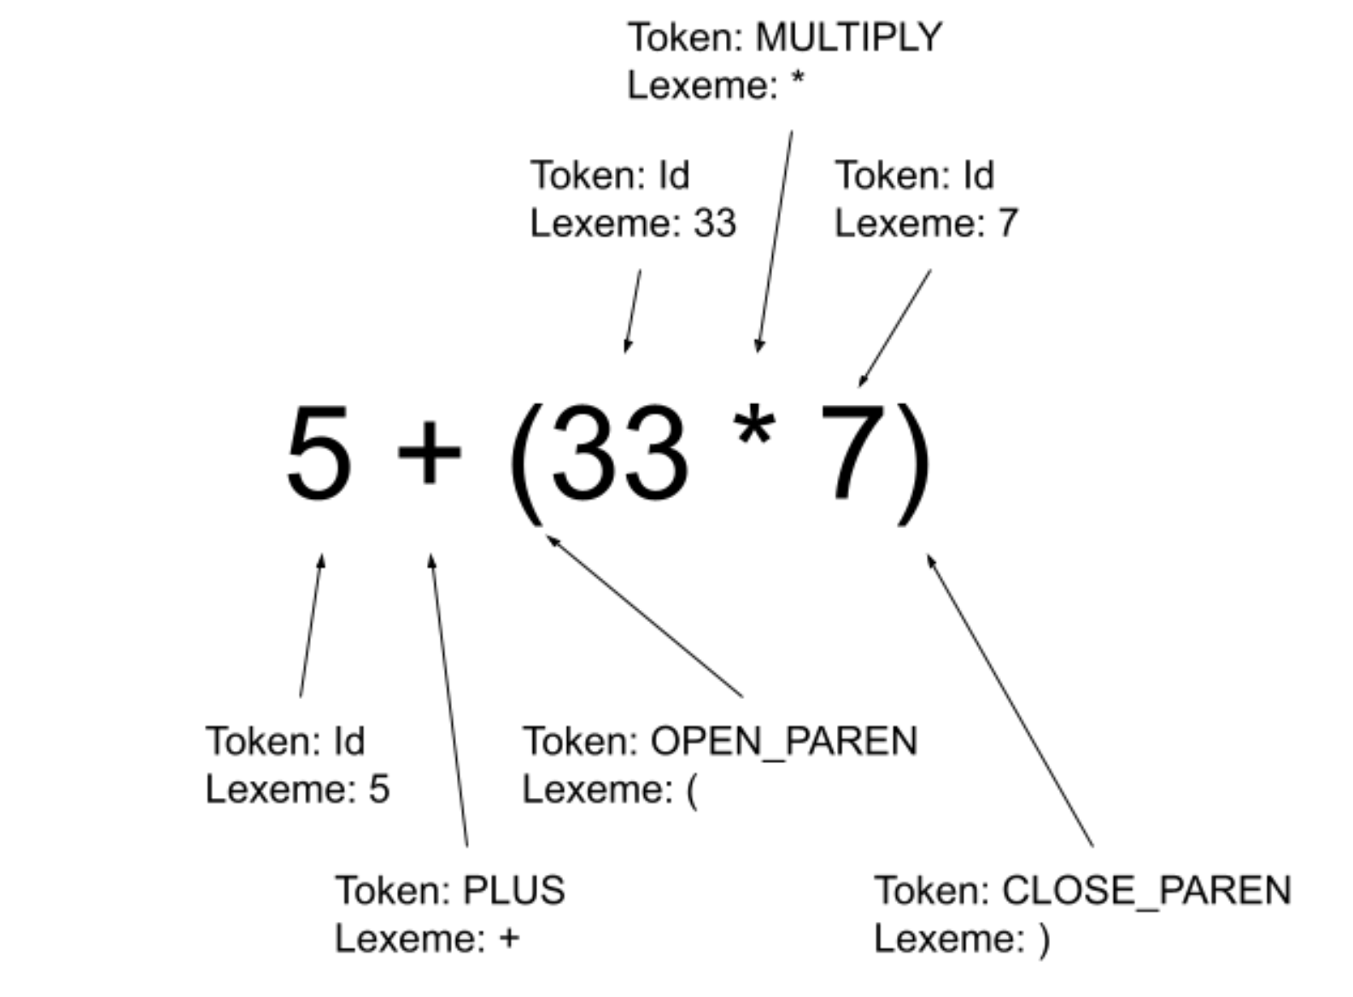
Tokens and Lexemes

Slide 18
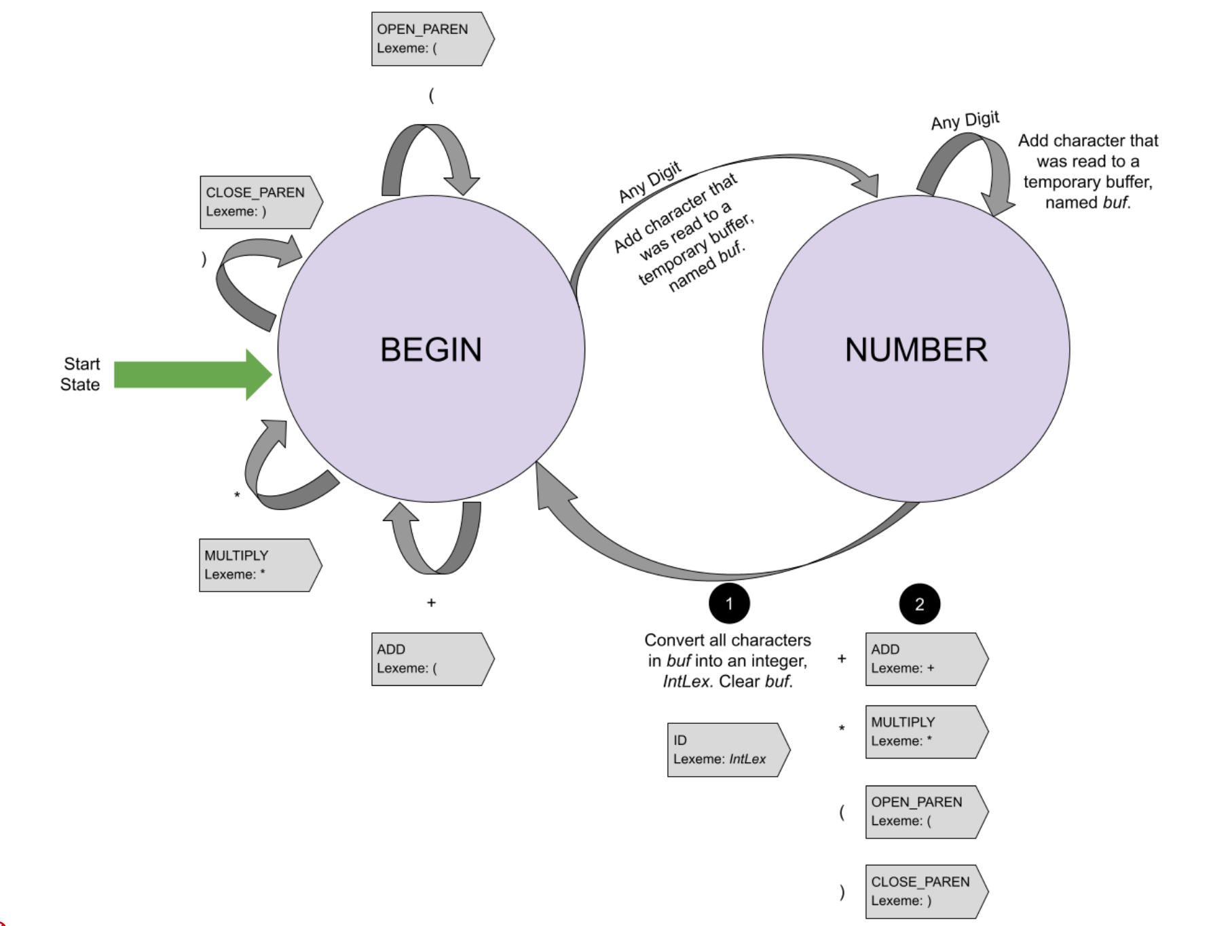
FA to convert bytes into tokens and lexemes

Slide 19
Recursive Descent Parsing

Slide 20
Limitation?
fundamental limitation of recursive-descent parsing: The grammars that it parses cannot contain productions that are left recursive.

Slide 21
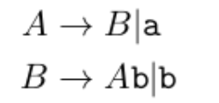
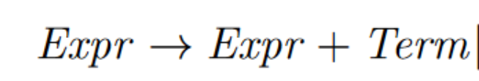
Left Recursive Grammar
Indirect Left Recursive Grammar
Direct Left Recursive
Grammar

Slide 22
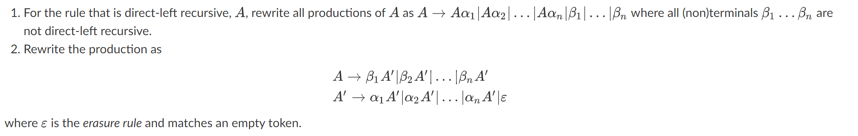
Formalism To The Rescue

Slide 23
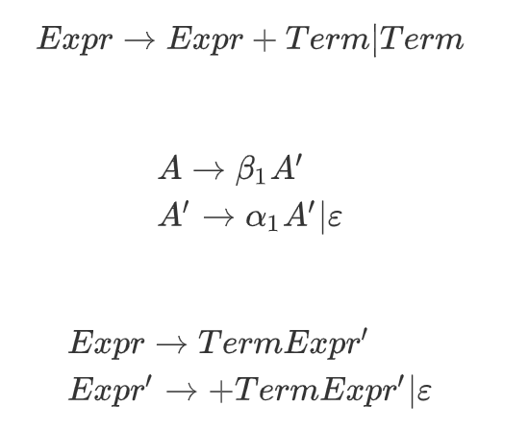
Formalism To The Rescue

Slide 24
Derivation

Slide 25
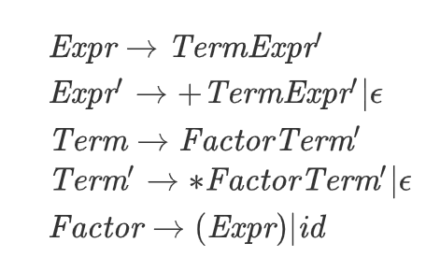
Formalism To The Rescue

